Slide 1


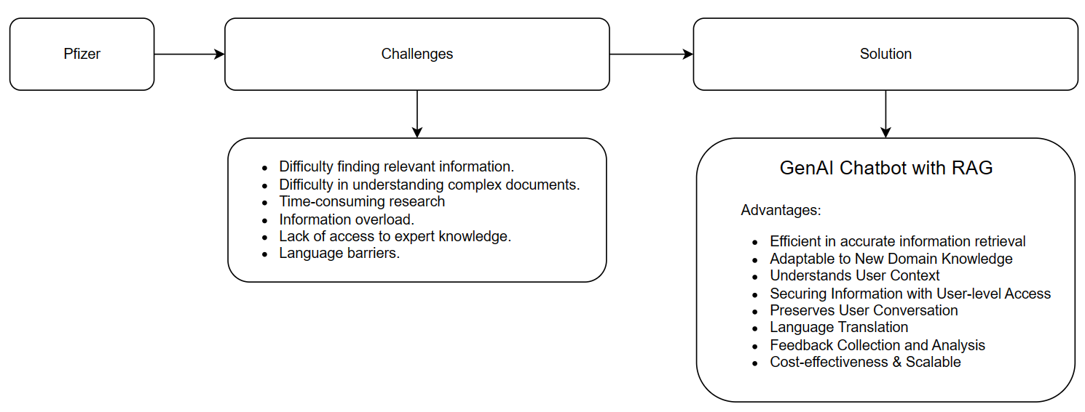
Pfizer – Theia
Use case: Knowledge based Q&A Chatbot

Slide 2
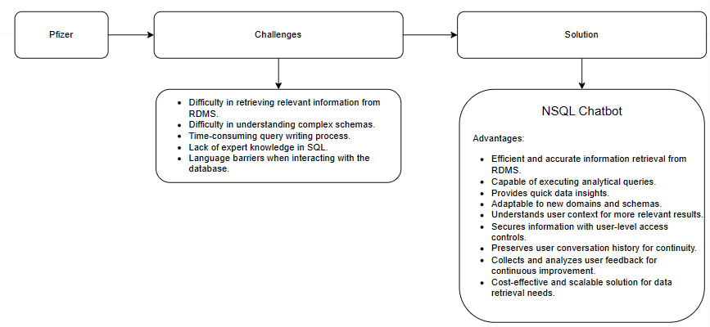
Pfizer – Theia
Use case: NSQL Q&A Chatbot

Slide 3
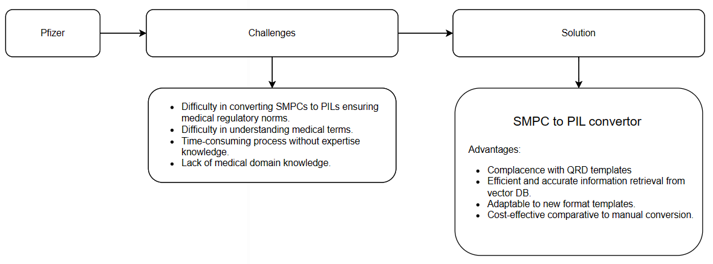
Pfizer – Theia
Use case: SMPC to PIL Conversion

Slide 4
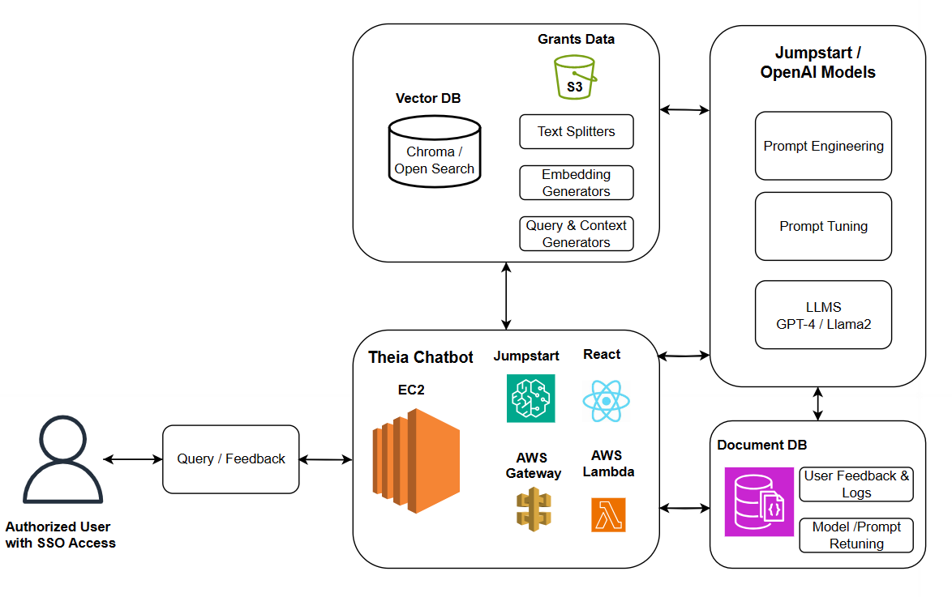
Pfizer – Theia
Business Scenario
Solution Architecture
Theia is designed to assist healthcare professionals and researchers in accessing medical grants information quickly and efficiently.
Overview
Theia is a chatbot assistant meant for retrieving the Grants research data including research data, approvals and payments.
Main objectives:
Developing pipelines to access the user data from S3, chunk them & generating the embedding for documents.
Utilize VectorDB for Storing Embeddings.
Developing the document retrieval pipelines using RAG
Leverage OpenAI Models for Generating Responses.
Set up AWS Gateway to monitor and manage the traffic to and from the chatbot.
Developing a user-friendly frontend interface using React.
Implement DocumentDB for Storing User Feedbacks and Logs and utilize for finetuning the models.
Containerize the application components using Docker to ensure portability, scalability.
4

Slide 5


Pfizer – Theia
Improve Productivity
Develop a document Q&A chatbot capable of retrieving medical grant details from multiple data sources using natural language queries.
Implement advanced natural language processing (NLP) techniques to understand user queries and generate accurate responses.
Develop a user-friendly frontend interface using React for seamless interaction with the chatbot.
Faster retrieval of required information
Project High level Objective
Reduce Research time
User understandable conversational sys
SCOPE OF WORK
OUT OF SCOPE
ASSUMPTIONS
Type
: Q&A Chatbot
Building data pipeline and injecting data from Oracle to snowflake.
Manual validation of chat responses.
Assumption that sufficient labeled data will be available for training and fine-tuning.
Assumption that the integration with third-party services OpenAI will proceed smoothly with providing necessary access.
Hosting
: EC2
Scope of work and Assumptions
Conversation Language
: English
Data sources : S3, Snowflake
Business Impact
LLMs : VOX / OpenAI, Jumpstart models
Frameworks : Langchain / Llama index

Slide 6
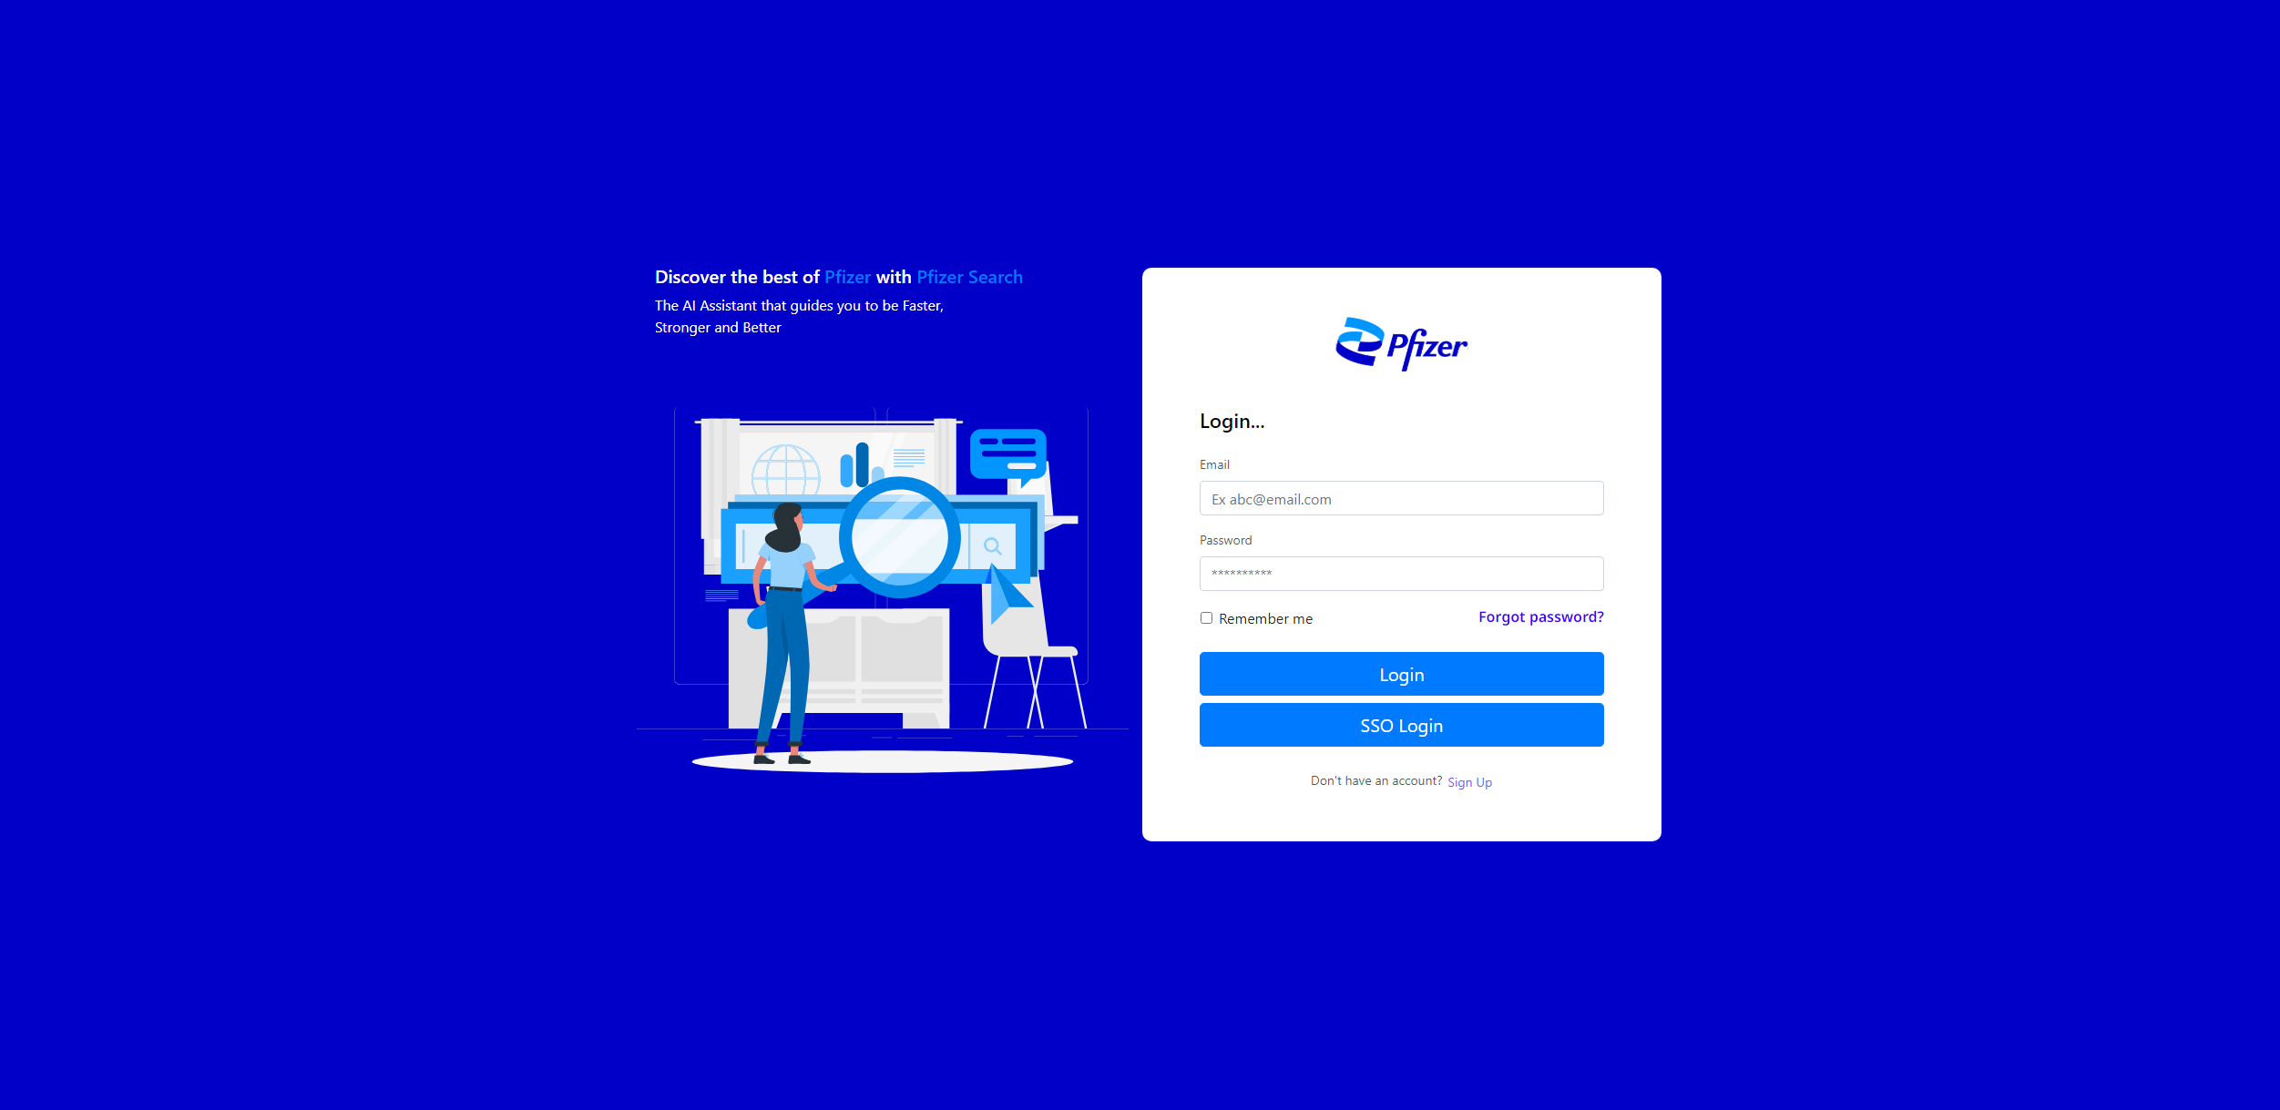
Pfizer – Theia
Theia – Login Screen with SSO

Slide 7
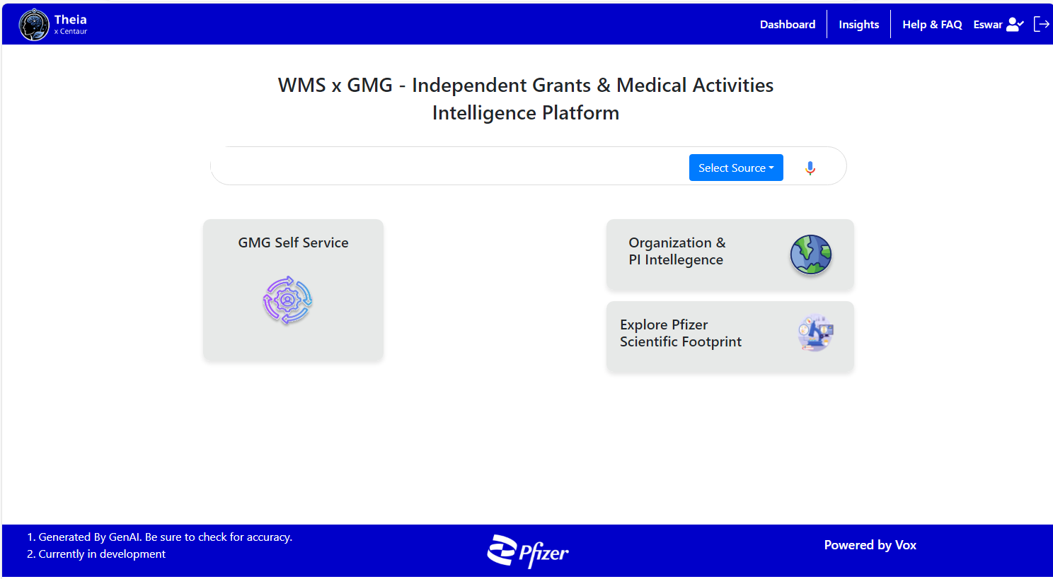
Pfizer – Theia
Theia – Chatbot Landing Page

Slide 8
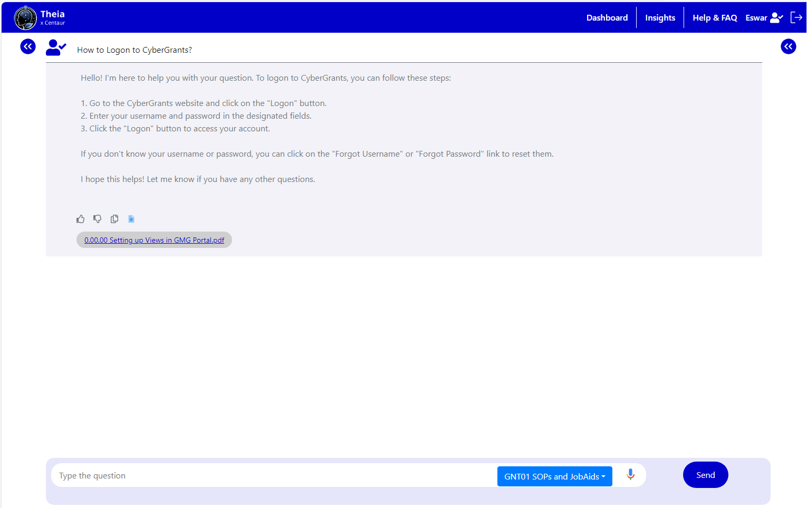
Pfizer – Theia
Theia – Chat Response for Document Q&A

Slide 9
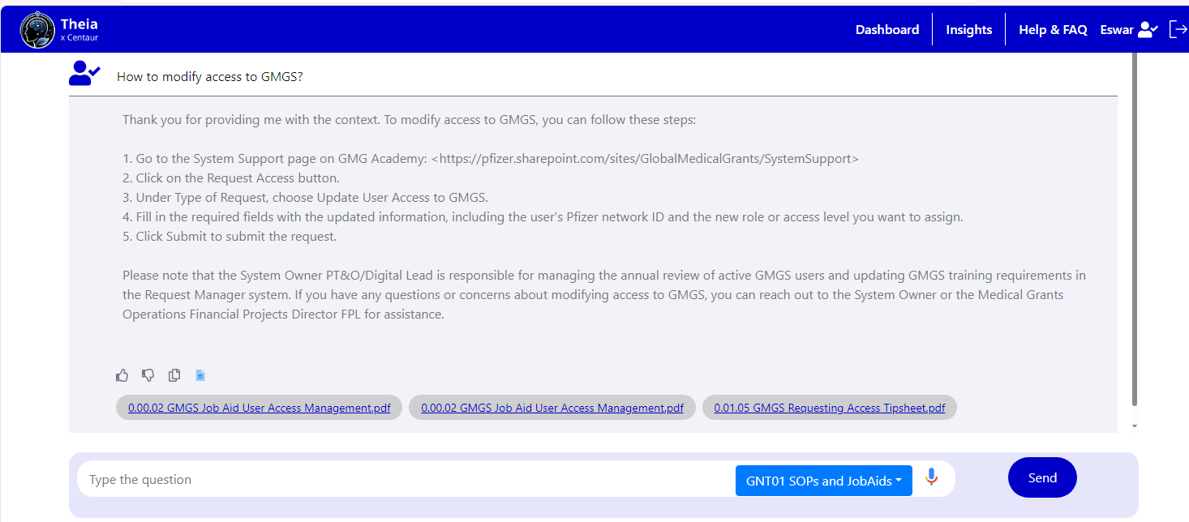
Pfizer – Theia
Theia – Chat Response for Document Q&A

Slide 10
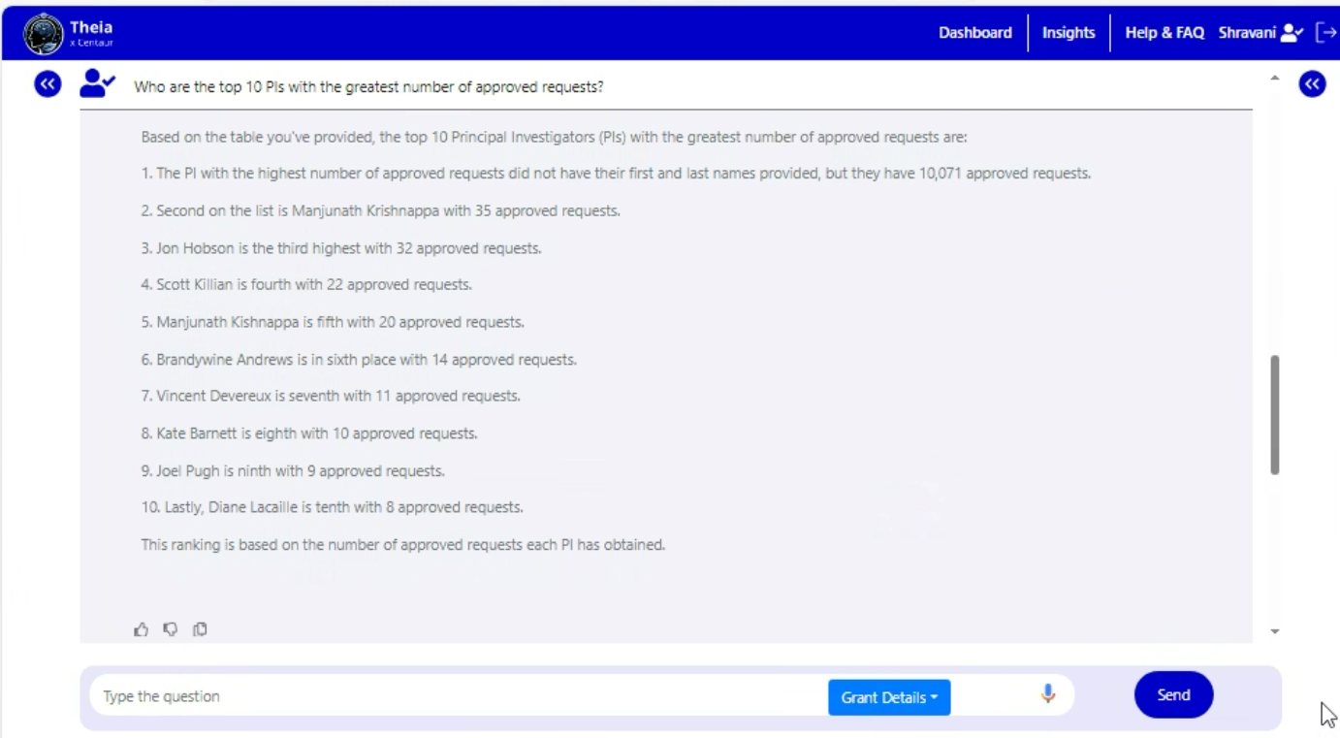
Pfizer – Theia
Theia – Text to SQL
Basic queries for fetching the top Personal individuals

Slide 11
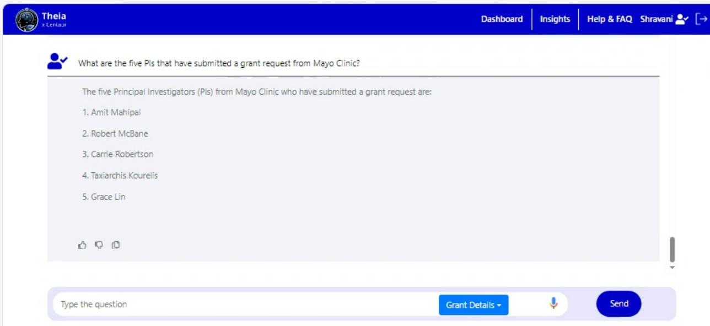
Pfizer – Theia
Theia – Text to SQL
Complex query involving multiple columns.

Slide 12
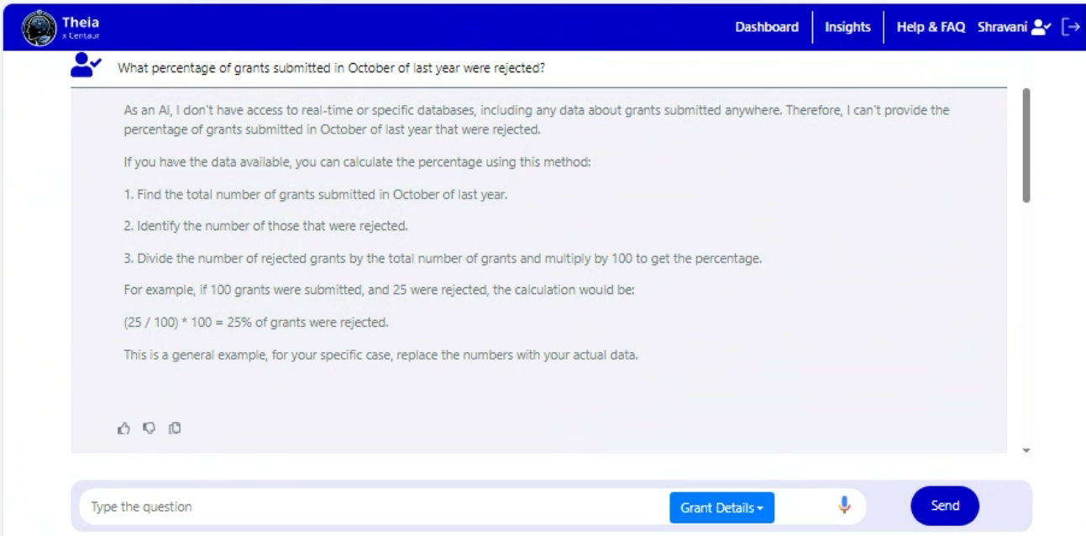
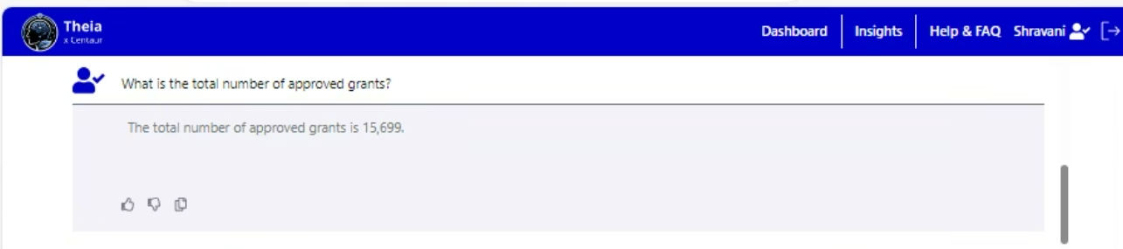
Pfizer – Theia
Theia – Text to SQL
Queries based on aggregation and computations

Slide 13
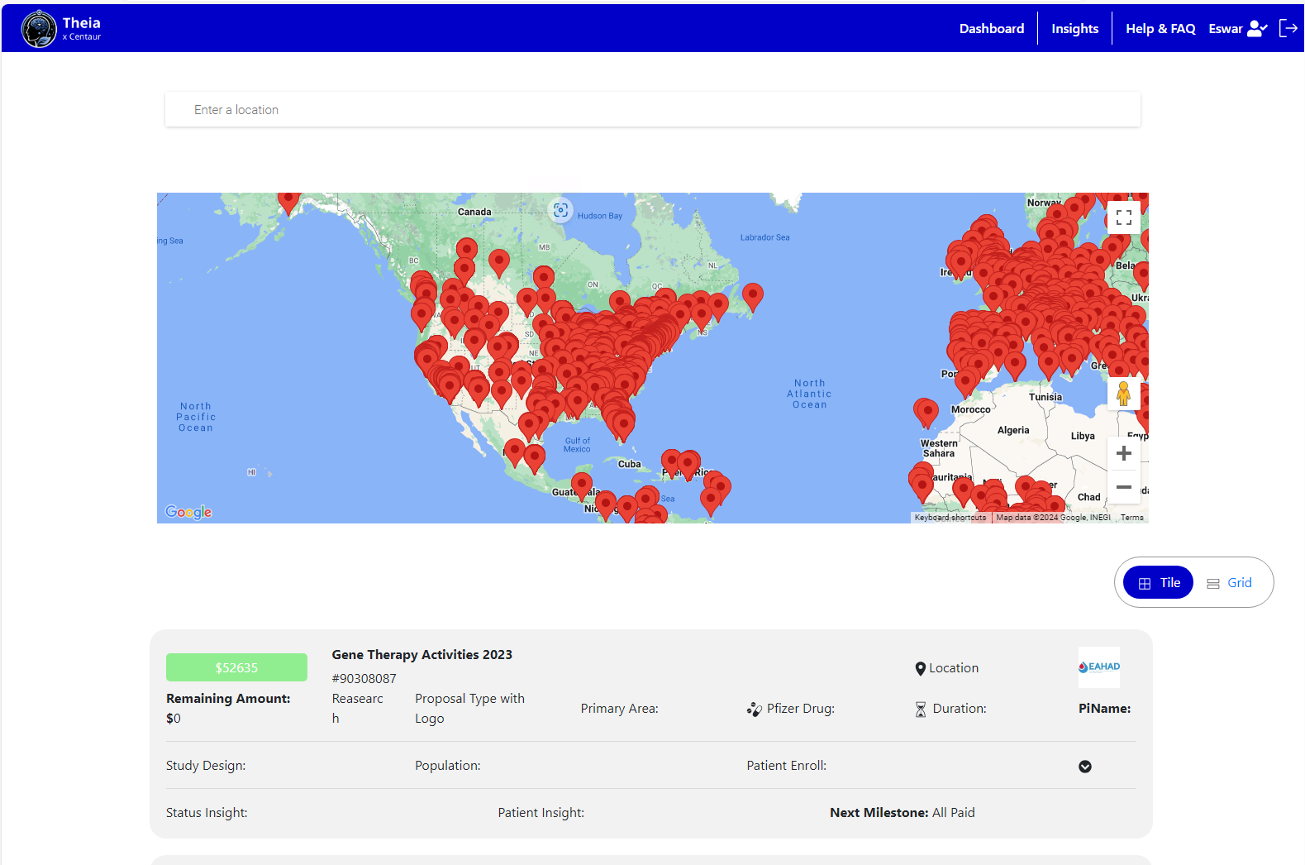
Pfizer – Theia
Theia – Grants Dashboard

Slide 14
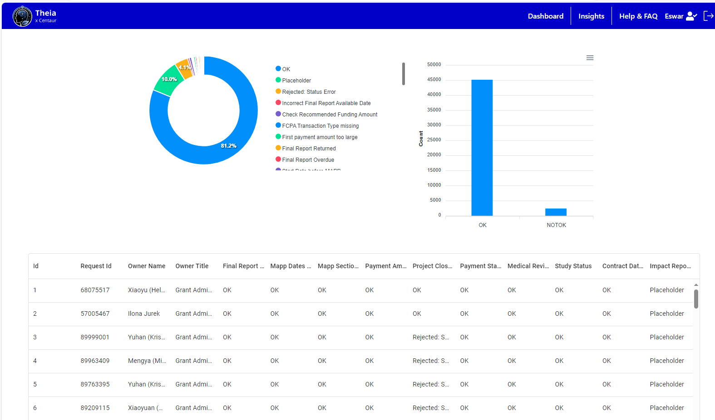
Pfizer – Theia
Theia – Grants Insights

Slide 15
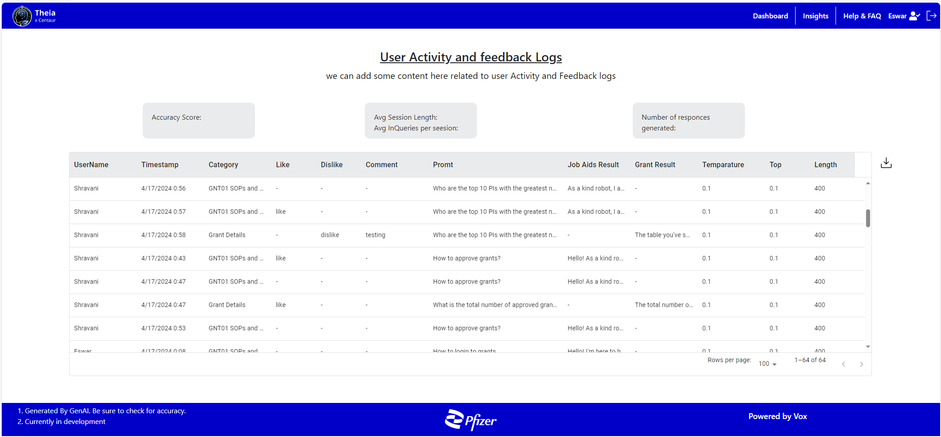
Pfizer – Theia
Theia – User Feedback Logs

Slide 16
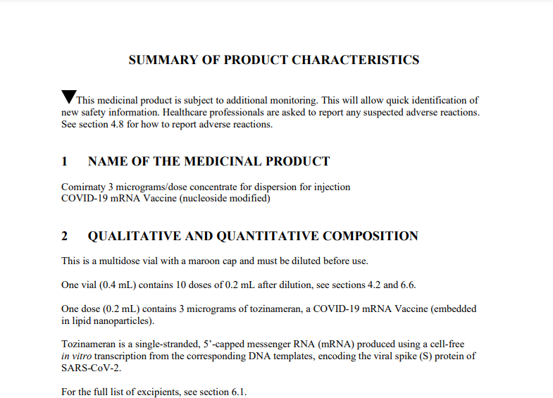
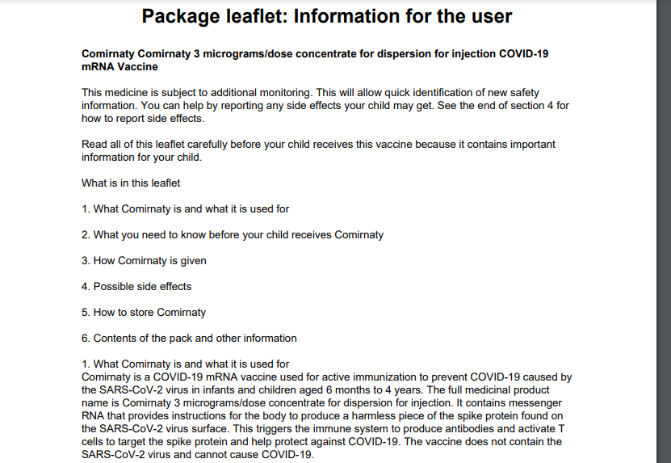
Pfizer – Theia
SMPC to PIL Conversion
Input SMPC Document
Output PIL Document

Slide 17
Pfizer – Theia
Thank you ...

